Slide 1
Syntactic and semantic models and algorithms in Question Answering
Alexander Solovyev
Bauman Moscow Sate Technical University
a-soloviev@mail.ru

Slide 2
Agenda
Question Answering and Answer Validation task
Answer Validation via Recognizing Text Entailment
Bags of Words/Links intersection [Wang 2008]
Tree edit distance [Panyakanok, Roth, Yih 2004]
Trees alignment [Marsi, Krahmer, Bosma, Theune 2006]
Predicates matching [Schlaefer 2007]
Parallel traversal [Solovyev 2010]
Automatic logic prove for logical forms [Akhmatova 2005]
Cross-application of syntax and semantic models in various algorithms

Slide 3
Question Answering

Slide 4
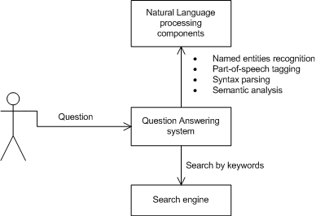
Meta-search architecture

Slide 5
Answer Validation task

Slide 6
Bag of words
Backup strategy in [Wang, Neumann. Using Recognizing Textual Entailment as a Core Engine for Answer Validation. 2008]
Used as baseline method or backup strategy
Given two sentences – question and snippet
Replace question focus by *ANS*
Replace answer in snippet by *ANS*
Remove stop words and punctuations
Count sets of distinct words in question and supporting text – Q and P
c=|Q∩P|/|Q|
Answer is supported by snippet if c > threshold (e.g. 0.7)

Slide 7
Bag of words example
What is the fastest car in the world?
The Jaguar XJ220 is the dearest, fastest and the most sought after car in the world.
→
*ANS* is the fastest car in the world?
The *ANS* is the dearest, fastest and the most sought after car in the world.
|Q∩P|={*ANS*, is, the, fastest, car, in, world}
c=|Q∩P|/|Q|=7/7=1.0

Slide 8
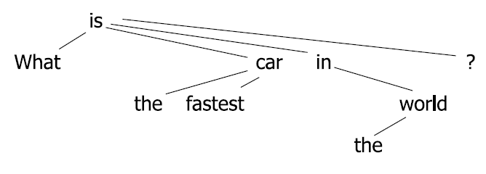
Bag of links example
*ANS*-is car-is the-car fastest-car
in-is world-in the-world ?-is
The-*ANS*
*ANS*-is
car-is the-car fastest-car in-is
world-in the-world .-is
…
c = |Q∩P|/|Q| = 7/7 = 1.0

Slide 9
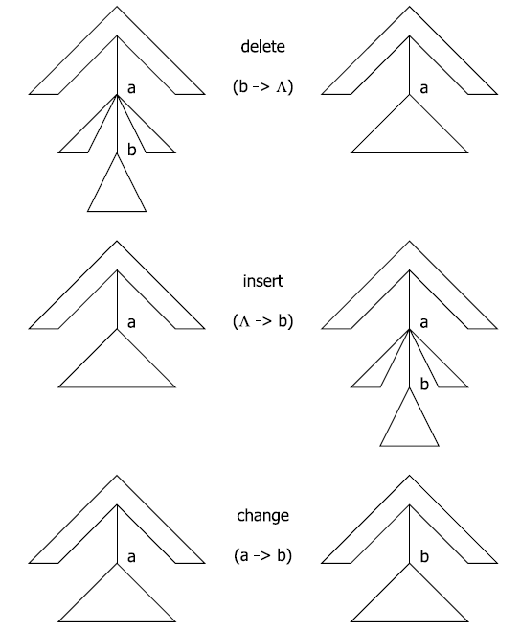
Tree edit distance
[Punyakanok et al. Natural Language Inference via Dependency Tree Mapping. An Application to Question Answering. 2004]
Given two ordered dependency trees representing question statement and snippet: T_{q}, T_{p}
Cost of deleting a node from tree: γ(a→λ)
Cost of inserting a node into tree: γ(λ→a)
Cost of changing a node: γ(a→b)
Cost of a sequence of operations S = <s₁; s₂;…; s_{k}> is γ(S) =Σ γ(s_{i})
Find a minimum cost of transformation T_{p} to T_{q}:

Slide 10
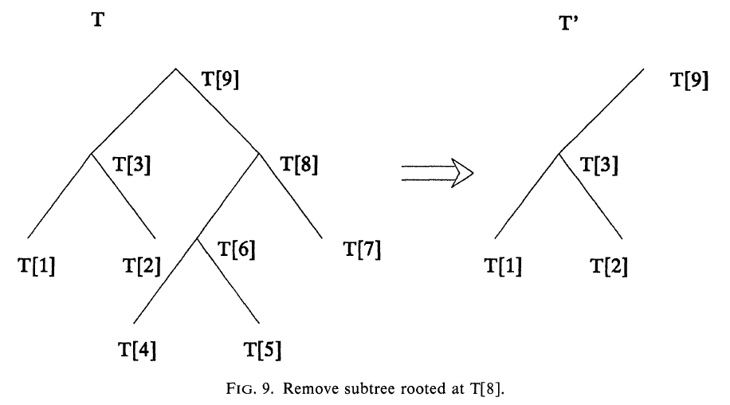
Tree edit distance with subtree removal
[Zhang, Shasha. Simple fast algorithms for the editing distance between tree and related problems. 1989]

Slide 11
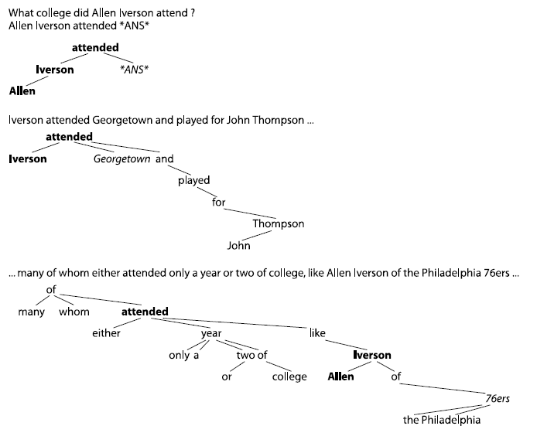
Tree edit distance vs Bag-of-words performance
[Punyakanok et al. Natural Language Inference via Dependency Tree Mapping. An Application to Question Answering. 2004]
TREC 2002 QA
Significant limitation of Zhang-Shasha algorithm: ordered trees only!

Slide 12
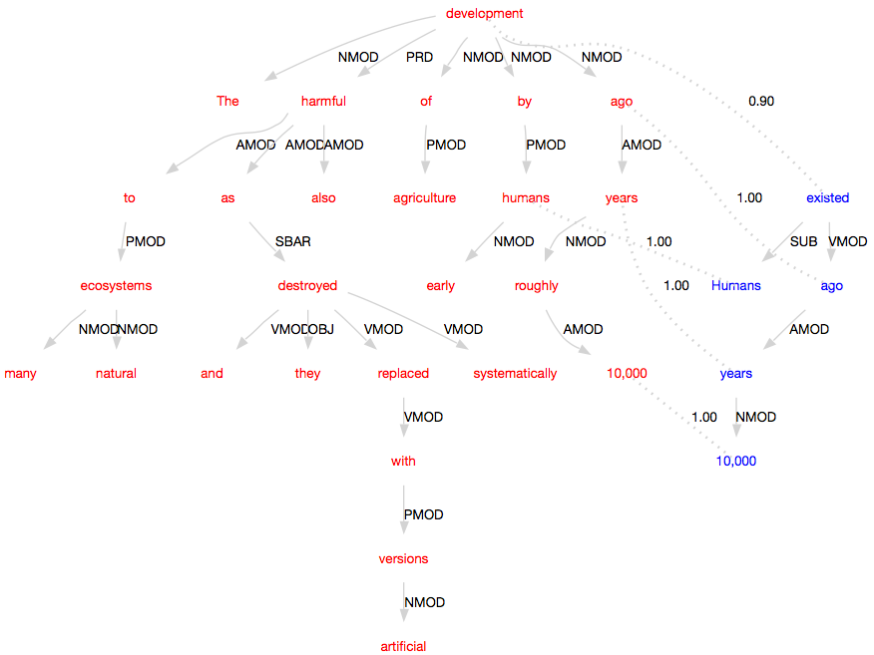
Trees alignment
[Krahmer, Bosma. Normalized alignment of dependency trees for detecting textual entailment. 2006]

Slide 13
Trees alignment
[Krahmer, Bosma. Normalized alignment of dependency trees for detecting textual entailment. 2006]
Given two dependency trees representing question statement and snippet: T_{q}, T_{p}
Skip penalty SP, Parent weight PW
Calculate sub-trees match matrix S=|T_{q}|x|T_{p}|
Every element s=<v_{q},v_{p}> to be calculated recursively
Trees similarity is a score of predicates similarity
Modification:
To replace question focus by *ANS*
To replace answer in snippet by *ANS*
to rotate trees to have *ANS* in roots, and use similarities of these roots.

Slide 14
Trees alignment
[Krahmer, Bosma. Normalized alignment of dependency trees for detecting textual entailment. 2006]
root node v can be directly aligned to root node v’
any of the children of v can be aligned to v’
v can be aligned to any of the children of v’ with skip penalty
P(v, v’) is the set of all possible pairings of the n children of v against the m children of v’, which amounts to the power set of {1…n}×{1…m}
|v’_{j}|/|v’| represent the number of tokens dominated by the j-th child node of node v’ in the question divided by the total number of tokens dominated by node v’.

Slide 15
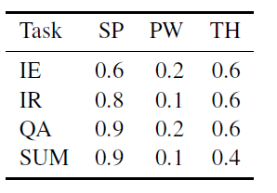
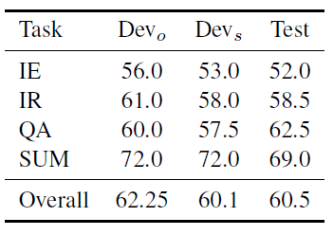
Trees alignment performance in RTE-2
[Krahmer, Bosma. Normalized alignment of dependency trees for detecting textual entailment. 2006]
parameters
BUT, For the RTE-2 test set, Zanzotto et al. found that simple lexical overlapping (sophisticated bag-of-words) achieves accuracy of 60%, better than any other sophisticated lexical methods they tested
accuracy

Slide 16
Predicates matching
OpenEphyra: [Schlaefer. A Semantic Approach to Question Answering. 2007]
Semantic Role Labeling:
Terms labeled either as predicates or arguments
Every term fills some predicate’s argument position
Predicate-argument relationship is labeled by type of argument: ARG0, ARG1, ARGM-LOC, ARGM-TMP etc.
Schlaefer’s method ignores labels and not uses deep syntax dependencies. SRL gives two-level hierarchy: predicates and arguments. Dependencies between arguments are not considered – they all depends on predicate.
<ARGM_TMP>In what year was</ARGM_TMP>
<ARG1>the Carnegie Mellon campus</ARG1>
<ARGM_LOC>at the west coast</ARGM_LOC>
<TARGET>established</TARGET>?
<ARG1>The CMU campus</ARG1> <ARGM_LOC>at the US west cost</ARGM_LOC> was <TARGET>founded</TARGET> <ARGM_TMP>in the year 2002</ARGM_TMP>

Slide 17
Predicates matching
[Schlaefer. A Semantic Approach to Question Answering. 2007]
Given two Semantic-Role-Labeled statements: question and snippet
Calculate similarity between all possible predicate-predicate pairs
Score of the best match to consider as answer confidence
-wordnet-based lexical similarity of terms

Slide 18
Predicates matching performance
[Schlaefer. A Semantic Approach to Question Answering. 2007]
Technique | Questions Answered | Questions Correct | Precision | Recall
Answer type analysis | 361 | 173 | 0.479 | 0.387
Pattern learning | 293 | 104 | 0.355 | 0.233
Semantic parsing | 154 | 90 | 0.584 | 0.201
Precision and recall on TREC 11 questions with correct answers (500 -53=447 factoid questions)

Slide 19
Parallel traversal
[Solovyev. Who is to blame and Where the dog is buried? Method of answers validations based on fuzzy matching of semantic graphs in Question answering system. Romip 2010]
Given two directed graphs representing semantic relations in question statement and in snippet
Replace focus by *ANS* in question and answer by *ANS* in snippet
Shortcut every node in snippet: for every pair of incoming and outgoing edge (e_{i},e_{o}) create a new edge (source(e_{i}),target(e_{o}))
(continued..)

Slide 20
Parallel traversal
[Solovyev. Who is to blame and Where the dog is buried? Method of answers validations based on fuzzy matching of semantic graphs in Question answering system. Romip 2010]
Calculate similarity of nodes *ANS* and *ANS* by recursive formula:

Slide 21
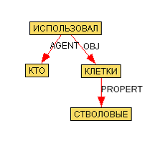
Parallel traversal
[Solovyev. Who is to blame and Where the dog is buried? Method of answers validations based on fuzzy matching of semantic graphs in Question answering system. Romip 2010]

Slide 22
Parallel traversal performance on ROMIP
[Solovyev. Who is to blame and Where the dog is buried? Method of answers validations based on fuzzy matching of semantic graphs in Question answering system. Romip 2010]
 | Recall | Error
myrtle-lucene (bag-of-words) | 0.083 | 0.598
myrtle-seman (parallel traversal) | 0.050 | 0.264

Slide 23
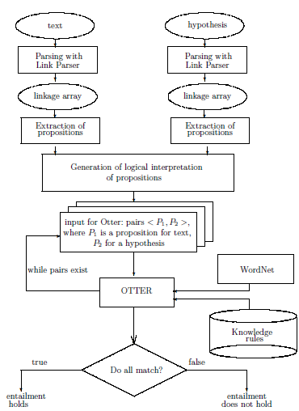
Automatic logic prove for logical forms
[Akhmatova et al. Recognizing Textual Entailment Via Atomic Propositions. 2006]
text. A boy bought a desk.
hypothesis. A boy bought a table.
Axiom extracted from WordNet:
X is a desk→X is a table
Input for Otter:
exists x exists y exists e (boy(x) & bought(e, x, y) & desk(y)).
all x (desk(x) → table(x)).
-(exists x, y, e (boy(x) & bought(e, x, y) & table(y))).

Slide 24
Automatic logic prove. Example.

Slide 25
Cross-application of models and algorithms
 | Bag of words | Syntax dependencies | Semantic dependencies | Logic forms
Sets intersection | Wang 2008 Zanzotto 2006 | A | Wang 2008
Predicates matching |  | B | Schlaefer 2007
Trees alignment |  | Marsi, Krahmer, Bosma, Theune 2006 | C
Tree-edit distance |  | Panyakanok, Roth, Yih 2004 | D
Parallel traversal |  | E | Solovyev 2010
Automatic theorem prove |  |  |  | Akhmatova 2005

Slide 26
Conclusion
There are many works on RTE and AVE in QA use Dependency trees
Authors usually stick to single parsing model from the very beginning till the end
There is an opportunity for replacing underlying model in existing algorithms (experiments A, B, C, D, E)
Looks like in most works syntax relations are enough, authors ignores sophisticated semantic attributes
Almost nothing done in Russian language
In current project all algorithms above implemented
Russian AVE collection is being developed…

Slide 27
References
QA overview:
Ittycheriah, Abraham. A Statistical Approach for Open Domain Question Answering // Advances in Open Domain Question Answering. Springer Netherlands, 2006. Part 1. Vol.32.
Prager, John. Open-Domain Question-Answering // Foundation and Trends in Information Retrieval, vol 1, no 2, pp 91-231, 2006.
Rodrigo, Á., Peñas, A., and Verdejo, F. 2009. Overview of the answer validation exercise 2008. In Proceedings of the 9th CLEF 2008. Lecture Notes In Computer Science. Springer-Verlag, Berlin, Heidelberg, 296-313.
RTE in QA:
Wang, Neumann. Using Recognizing Textual Entailment as a Core Engine for Answer Validation // Working Notes for the CLEF 2008 Workshop.
Panyakanok, V., Roth, D. and Yih, W. Natural language interface via dependency tree mapping: An application to question answering // AI and Math.- January 2004.
Zhang, Shasha. Simple fast algorithms for the editing distance between tree and related problems. 1989
Marsi, E. and Krahmer, E. and Bosma, W.E. and Theune, M. (2006) Normalized Alignment of Dependency Trees for Detecting Textual Entailment. In: Second PASCAL Recognising Textual Entailment Challenge, 10-12 April 2006, Venice, Italy.
Schlaefer, Nico. A Semantic Approach to Question Answering: Saarbrücken 2007.
Akhmatova, E. Textual Entailment Resolution via Atomic Propositions // Proceedings of the PASCAL Challenges Workshop on Recognising Textual Entailment, Southampton, UK (2005) 61–64.
Solovyev. Who is to blame and Where the dog is buried? Method of answers validation based on fuzzy matching of semantic graphs in Question answering system. Romip 2010
Tools:
http://aot.ru http://rco.ru http://mu.lti.cs.cmu.edu/trac/Ephyra/wiki

Slide 28
Thanks
Questions?
a-soloviev@mail.ru
http://qa.lib.bmstu.ru

