Slide 1

A Full-Text Search Algorithm for Long Queries
Laboratory of
Information
Systems
Tula State University
Faculty of Cybernetics
Alexey Kolosoff, Michael Bogatyrev

Slide 2
Table of Contents
Problem statement
Suggested algorithm
Queries processing
Documents ranking
Experimental results

Slide 3
Problem statement
Suggested algorithm
Queries processing
Documents ranking
Experimental results

Slide 4
Environment
A question-answer portal is considered. Answers are produced by technical support persons.
Several existing databases may contain the needed answer for a question.
The task is to decrease the workload of the support team.

Slide 5
Workflow
Customer
Web form
Support
Before:
Search helps
Customer
Web form
Support
Search
Search doesn’t help
After:

Slide 6
Data Processing
Q&A database
Forums
E-mail
Web form
Documents database (help, FAQ, etc.)
Support team
Search system
Customers’ questions
(natural language text)
Links to documents
Input
Output

Slide 7




Slide 8
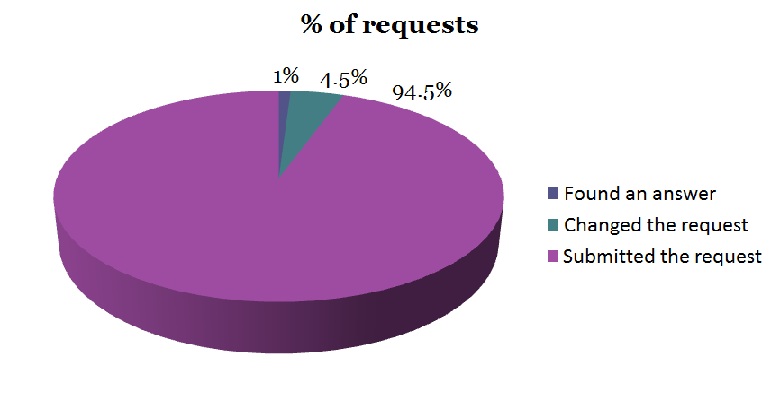
Using Message Subject for Search - Results

Slide 9
Why it’s not a Typical Web Search
Queries consist of multiple sentences, instead of several keywords
The number of documents is not very big (tens of thousands)
Indexed documents consider a single subject or several related subjects

Slide 10
Problem statement
Suggested algorithm
Queries processing
Documents ranking
Experimental results

Slide 11
The Suggested Algorithm
Build CG for input text, filter out unrelated words
Get concepts mentioned in the text (context matrix)
Get documents with the same concepts (filter out irrelevant documents)
Rank documents

Slide 12
Advantages of the Algorithm
Words and sentences filtering allows excluding words and phrases which possibly do not affect the meaning of the text. The task of text search decreases to phrases search.
Using concepts for articles filtering decreases the impact of polysemy on search results.
Getting articles with specific concepts is expected to be faster than searching for articles with specific keywords in the entire corpus.

Slide 13
Problem statement
Suggested algorithm
Queries processing
Documents ranking
Experimental results

Slide 14
Queries Processing
Noise words filtering
Phrases detection
Word forms expansion (with lesser weight)
Synonyms expansion (with lesser weight)

Slide 15
Phrases Detection – Punctuation Marks (During Indexing)
Examples:
issue-tracking tools => [N, N + 0.25]
...the issue, but{stop word} tracking changes... => [N, N + 3]
Object.Method() =>
Object[N], Method[N + 0.25]
…some object. Method A shows… => object[N], Method[N + 15]

Slide 16
Phrases Detection - Semantics
Despite possible errors, users tend to use correct word combinations for technical details description.
A conceptual graph build from a question’s text allows filtering out unrelated words and word combinations which are not grammatically correct.

Slide 17
How Conceptual Graphs are Built
Morphological analysis
word formation paradigms from Russian & English languages
using dictionaries
Semantic analysis
semantic role labelling
using templates

Slide 18
Sample Query
“Hi there!
i have a script test with a bunch of checkpoints, but when it hits a checkpoint cannot be verified, the execution of the script stops and any tests after the failed checkpoint do not get executed.
Thank's in advance.
Randy”

Slide 19
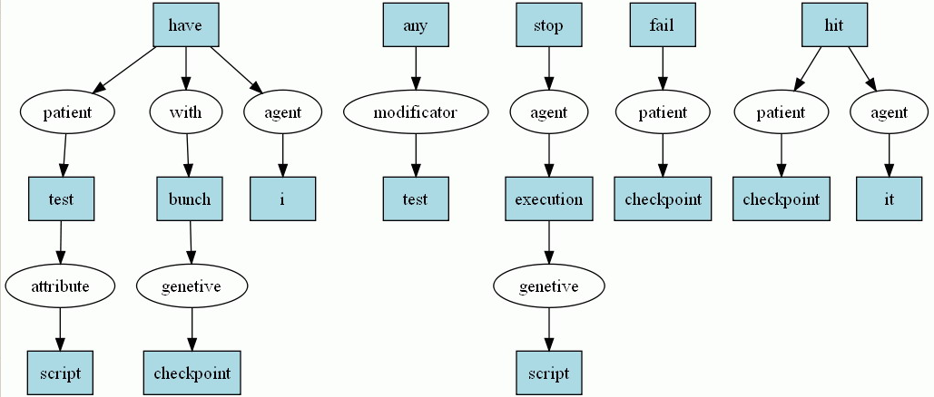
A Conceptual Graph Fragment

Slide 20
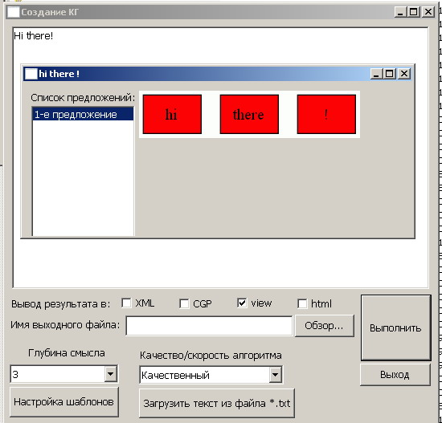
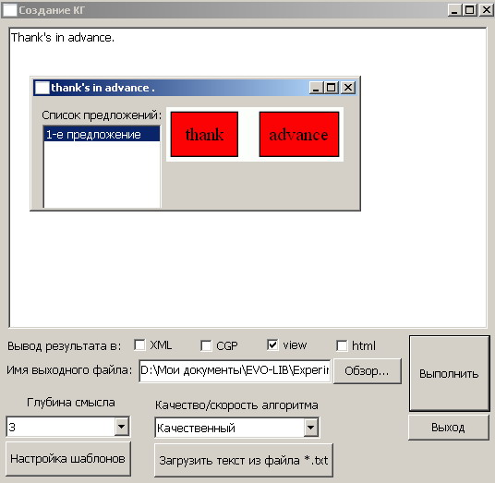
Filtered out Sentences

Slide 21
Parsing results
Phrases used as an input for full-text search.
Each phrase has its own weight.
As a result, the task of searching for a given text can be reduced to searching for a number of phrases. This task can be solved via the suggested algorithm.

Slide 22
Problem statement
Suggested algorithm
Queries processing
Documents ranking
Experimental results

Slide 23
Document Model
Vector model is used to represent an indexed document or a query:
The native methods of the control =>
[the (0.333), native(0.166), methods(0.166), of (0.166), control(0.166)]
[0, 5] [1] [2] [3] [4]

Slide 24
The Sought-for Phrase is Present in an Indexed Document if…
...(distance between each words pair) < M, where M is the artificial word position increment value for sentence breaks.
Sample query: AJAX applications testing
AJAX web applications are, indeed, difficult for testing. => total words distance: 7
No AJAX applications. Testing desktop applications is another task. => total words distance: 16

Slide 25
Phrases Relevance
Arithmetical mean for each phrase (pi) detected in a query (q).
Where wpi – the weight of the phrase in the query,
Rp – document’s relevance for p_{i} calculated via the following formula:
where – the number of words in pi,
– total words distance in a document (dj), calculated for each occurrence of pi.

Slide 26
Resulting Relevance
where Rphrase – phrases relevance,
Wfield – indexed field’s weight

Slide 27
Problem statement
Suggested algorithm
Queries processing
Documents ranking
Experimental results

Slide 28
Performance Measurement Formula
where reli – assessor-defined relevance [0..2],
i – the result’s order number,
p = 10 – the number of considered results

Slide 29
Experimental Results
The average quality of «top 10» search results
(discounted cumulative gain), max=10,51
Number of queries

Slide 30
Conclusions
It is necessary to perform phrase search when finding an answer in an automated way.
Conceptual graphs allow detecting phrases in natural language queries.
Storing conceptual graphs instead of document vectors as indexes and using the graphs directly for relevance calculation can be an interesting approach, which will be examined in a future work.

Slide 31
Thank you! Any questions?

